Slide 1
BTMW 4012 TECHNOLOGY ENTREPRENEURSHIP Lecture 1: Introduction to Entrepreneurship
FPTT - UTeM

Slide 2

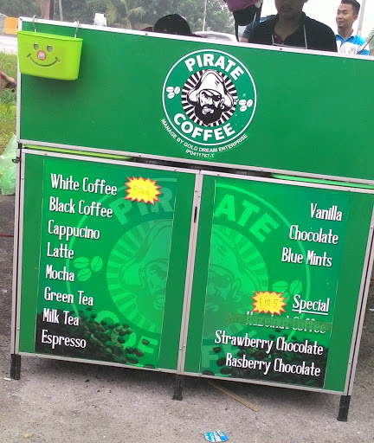
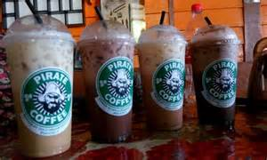

Slide 3
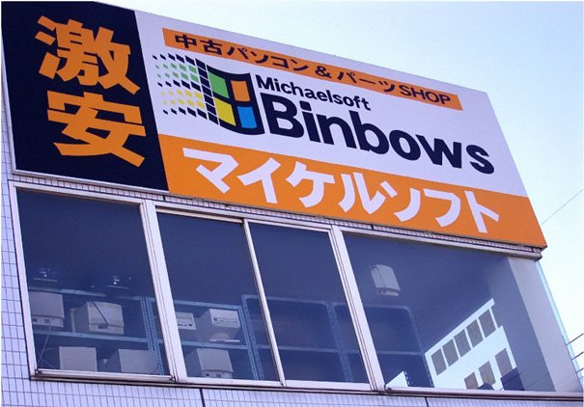


Slide 4
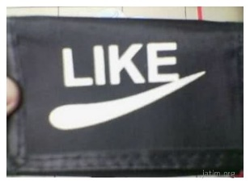
Technology Business Potential : I- Sajadah from UTeM
https://youtu.be/3BDmykLr1iE

Slide 5
Introduction
The study of entrepreneurship has emerged to be very important in countries that practise free market economy.
In most of these countries, entrepreneurial development is an important agenda in nation building.
There exists a need to understand entrepreneurship and its salient issues.

Slide 6
Introduction to Entrepreneurship
In a free market economy, entrepreneurs are key players or providers that produce, transport or sell products and services to consumers.
They seek business opportunities by identifying what is needed, wanted or desired by consumers.
Entrepreneurs create new products, take risks in investing money and make the products available to customers.

Slide 7
Introduction to Entrepreneurship (cont.)
Consequently, consumers get to choose the best products or services best suited to their needs and budget.
New and improved products are continuously developed to replace older products, and these products have enhanced the standard and quality of life of the society.
Thus, entrepreneurial activities are pillars of a nation’s economic progress, growth and prosperity.

Slide 8
Introduction to Entrepreneurship (cont.)
A society that has a great entrepreneurial culture will be more productive, competitive and prosperous.
By nature, entrepreneurs will always try to improve product quality, reduce cost of production, find better ways to serve their customers and thus serve customers’ needs more effectively.
Their ability to mobilize and allocate resources to where it is most needed based on business opportunities or market demand, make entrepreneurs the most efficient resource allocators in a free market economy.
Many successful entrepreneurs have become very rich when their small businesses grow into big corporations.

Slide 9
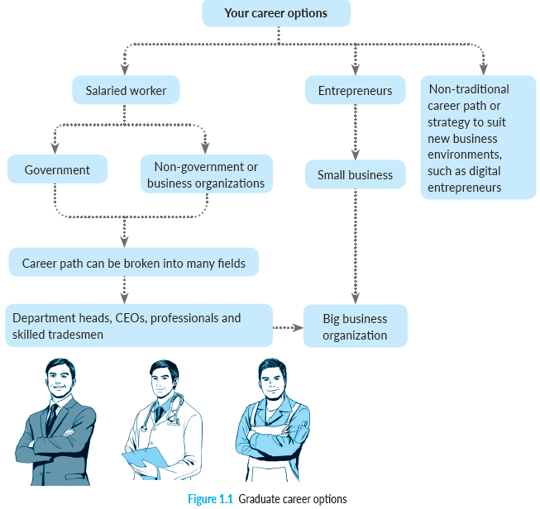
Introduction to Entrepreneurship

Slide 10
Definitions of Entrepreneurship and Entrepreneur
Entrepreneurship can be defined as
“the activity of setting up a business or businesses, and taking on financial risks in the hope of making profit.”
The study of entrepreneurship includes the study of entrepreneurial behaviour, as well as the dynamics of business set-up, expansion and development.

Slide 11
Definitions of Entrepreneurship and Entrepreneur (cont.)
The term ‘entrepreneur’ was first used by a Frenchman named Richard Cantillon (1775) to mean ‘a person who undertakes to do a job’.
Adam Smith (1776) defines an entrepreneur as a person who acts as an agent in transforming demand into supply.
Jean-Baptiste Say (1803) considers an entrepreneur as a person who shifts resources from an area of low productivity to high productivity.

Slide 12
Definitions of Entrepreneurship and Entrepreneur (cont.)
In short, entrepreneurs are the prime movers of economic progress.
They can be innovators, they mobilize resources to provide products and services needed, and in the process, they build businesses that provide jobs.
Thereby improve the standard of living and quality of life of the people. They are the catalysts that contribute to the nation’s economic progress.

Slide 13
Entrepreneurial Process
The Timmons Model of Entrepreneurial Process best describes the four major necessary components in venture creation:
Founder
Opportunity
Team
Resources

Slide 14
Entrepreneurial Process (cont.)
An entrepreneurial process is led by an entrepreneur who is able to seize and act on an opportunity.
Together with his team, the entrepreneur will package a viable offering to customers using available resources. He may use his own money or canvass others to invest with him. He may need to convince others with required skills to be part of his team to execute the project and produce products and services for customers.

Slide 15
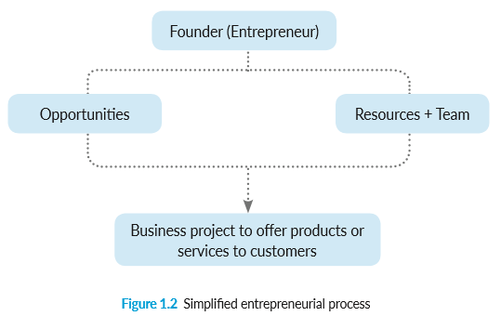
Entrepreneurial Process (cont.)

Slide 16
Characteristics and Attributes of Entrepreneurs
Successful entrepreneurs always have a strong reason or mission for becoming an entrepreneur.
For example, he likes promoting certain business values, solving specific problems, addressing some needs or exerting influence within an industry.
Take Steve Jobs of Apple—he ‘disrupted’ and changed industries for which he created the personal computer to make computing personal, rather than limiting it only for large organizations.

Slide 17
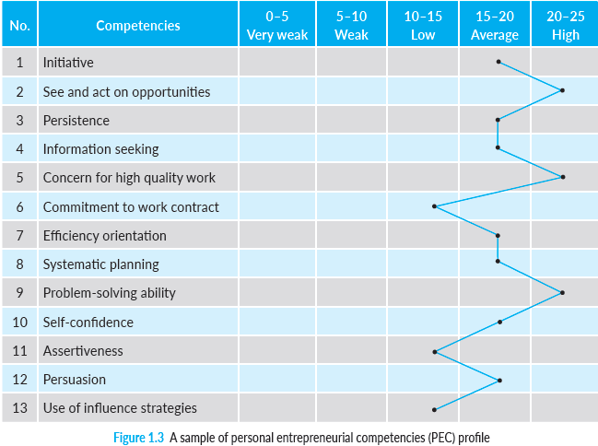
Characteristics and Attributes of Entrepreneurs (cont.)

Slide 18
Characteristics and Attributes of Entrepreneurs (cont.)
The common characteristics of entrepreneurs:
Creative, innovative, resourceful and possess high level of initiative.
Willingness to work hard to achieve aspired objectives with a high degree of commitment, determination, perseverance, tenacity and discipline.
Ability to take calculated risk, exhibit tolerance for ambiguity and ability to accept failure.
Possess ability to think independently, exhibit high level of self-confidence, optimistic and believe in controlling one’s own destiny.

Slide 19
Characteristics and Attributes of Entrepreneurs (cont.)
Opportunity orientation towards future goals, aspiration and vision.
Skilful organizer, ability to manage and solve problems.
Communicative and persuasive ability to influence others.
Although these are common among entrepreneurs, it must be said that different types of entrepreneurship may require different entrepreneurial characteristics or different combinations of entrepreneurial characteristics.

Slide 20
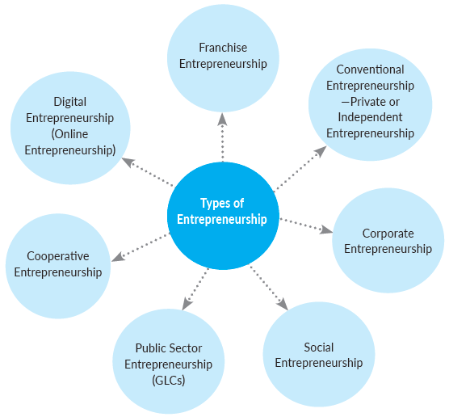
Types of Entrepreneurship
Broad categorization of the types of entrepreneurship can be seen in Figure 1.4 where the entrepreneurial activities are carried out in different forms of organizations.

Slide 21
The Chicken Rice Shop
Old Town White Coffee
Q Dees
Marry Brown
The Manhattan Fish Market
Online Tuition: Example MC PLUS
Ecommerce/dropship/affiliate marketing: Example AAFIYAT AFFILIATE BIZ
Real Estate Agency
Tourism & Travel Agency
Car Driving School
Electronic manufacturers in Malaysia
Bank Persatuan, Koperasi Telekom, and Koperasi Angkatan Tentera Malaysia Berhad
Melaka State Development Corporation
Perak SEDC
Teach for Malaysia is an independent social enterprise
mission to end education inequity in Malaysia

Slide 22
Micropreneurs
Not every person who starts a business has the mission of making a lot of money and growing it to a world-class business.
Some just want a simple balanced life-style while doing the kind of work they enjoy doing.
Business writer Michael LeBoeuf calls such business owners “Micropreneurs”
Many micropreneurs are small home-based business owners who are trying to combine career and family.
FPTT - UTeM

Slide 23
Intrapreneurship
Intrapreneurship is the process by which individuals pursue a new business opportunity (or by setting up intraprises) from within an existing company, with resources of that company.
It uses the advantages of both small and big scale business. In board sense, intrapreneurship refers to all kinds/forms of semi-autonomy and semi-responsibility within corporations.
IPTK - UTeM

Slide 24

Intrapreneur
In 1978, management consultant, Gifford Pinchot, invented the word intrapreneur to refer to an intra-corporate entrepreneur while he was attending the School for Entrepreneurs in Tarrytown, New York.
A person within a large corporation who takes direct responsibility for turning an idea into a profitable finished product through assertive risk taking and innovation.
FPTT - UTeM

Slide 25
What is Technopreneur?
Entrepreneur who uses technology to be involved in business activities.
From the words;
Technology
+ = “Technopreneur”
Entrepreneur
The role of scientist/engineer’s entrepreneur or so called technopreneur is to effectively move a technology invention from concept to market
FPTT - UTeM

Slide 26
Technopreneur
“Technopreneur” is coined just a couple of years back to refer to Technology Entrepreneur.
This term appears to be most actively used in Singapore, and to some extent also in Malaysia and Thailand.
Technopreneurs are the ones who identify the problems and capitalized on the opportunity.
A technopreneur has two major characteristics:
He does things NOT out of profits but because he wants to innovate.
He is comfortable working with, or, using technology.
FPTT - UTeM

Slide 27
Technopreneur & Entrepreneur
TECHNOPRENEUR
= Today + Future = Vision
ex. Bill Gates = Technopreneur
ENTREPRENEUR
= Product + Market = Profits
ex. Dato' Seri Dr. Hajah Vida = Entrepreneur
FPTT - UTeM

Slide 28
Leadership Roles of Technopreneurs
Creating vision, direction, goals
Communicating with followers
Motivating and empowering
Affirming/reaffirming values
Aligning people – achieving workable unity
Serving as a symbol
Management of thrust
Management of Self
FPTT - UTeM

Slide 29
Comparison Between Entrepreneur and Technopreneur
ENTREPRENEUR | TECHNOPRENEUR
Likes to compete Self-starter Able to do many things at once Is creative, and has dreams and goals Likes to work for him/herself and be in control Is motivated by a strong desire to achieve and attain financial success Focuses his/her attention on the chances of success rather than the possibility of failure | Likes to innovate Part of a team Able to do many things at once, but chooses to delegate Is innovative and has a grater vision Likes to be the one to control innovation and be part of an evolution Is motivated by a strong vision and his passion to innovate Take failure in stride and knows it will lead to success if correction can be made

Slide 30
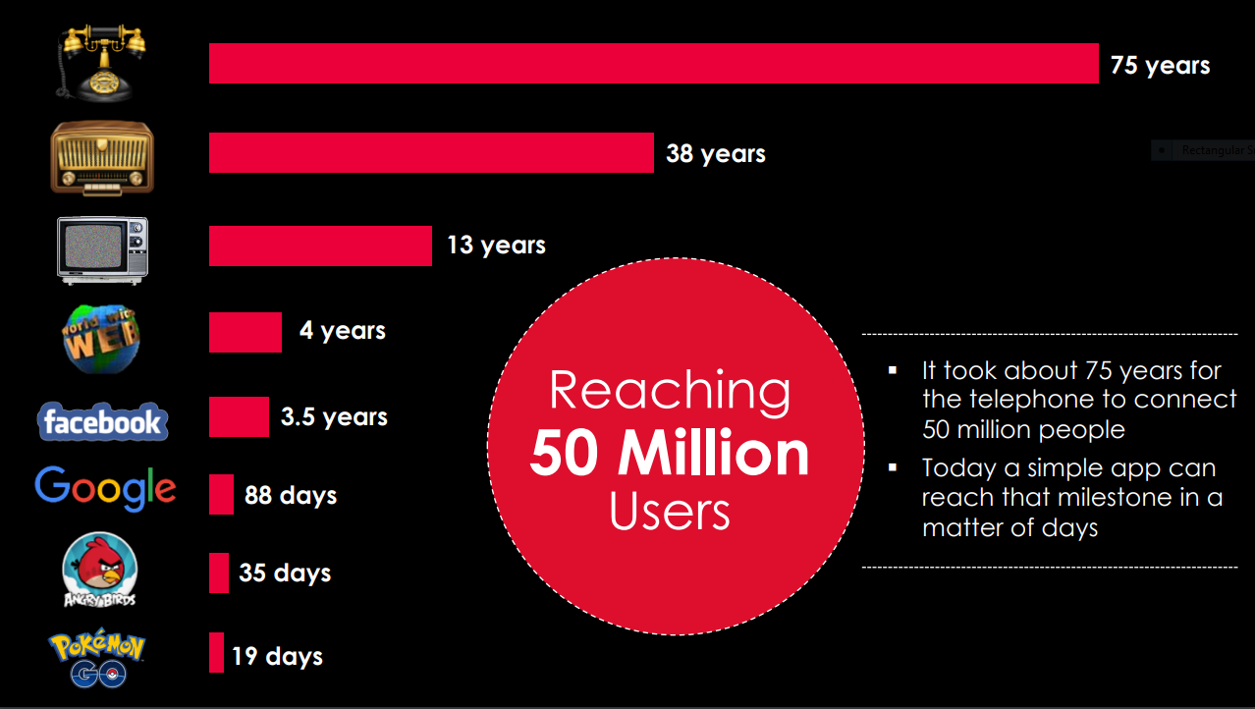
Conventional Entrepreneurship vs Digital Entrepreneurship

Slide 31
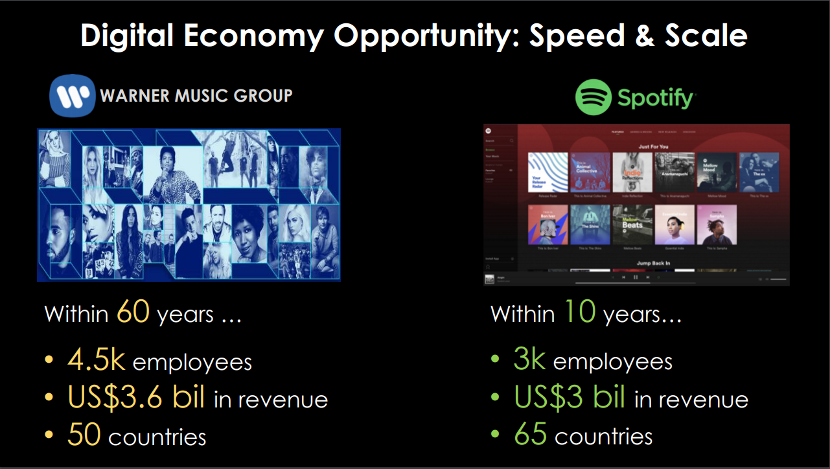
Conventional Entrepreneurship vs Digital Entrepreneurship

Slide 32
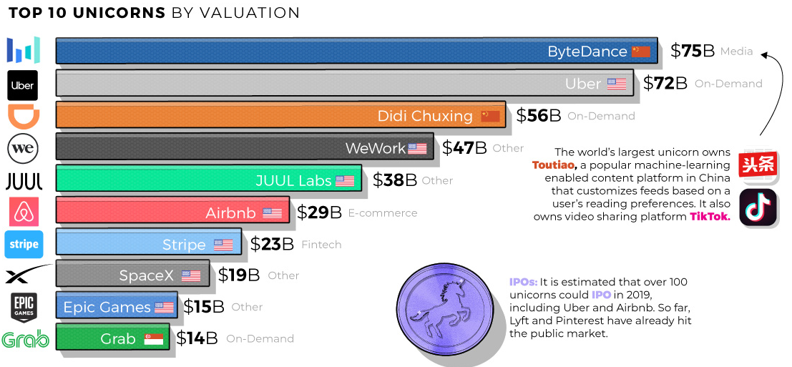
Conventional Entrepreneurship vs Digital Entrepreneurship

Slide 33
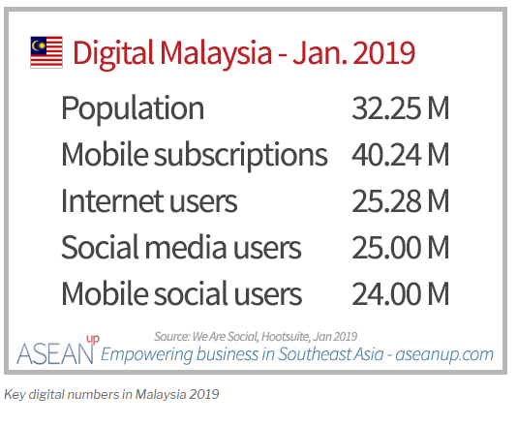
Digital Entrepreneurship in Malaysia

Slide 34
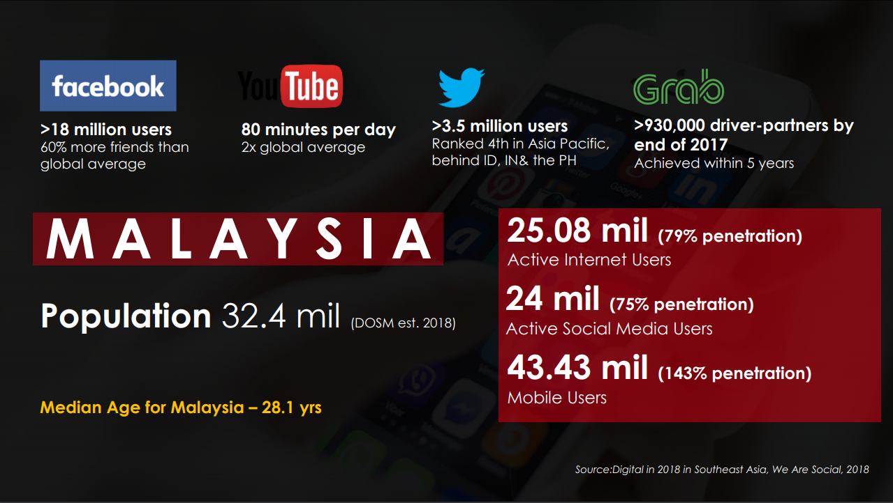

Slide 35
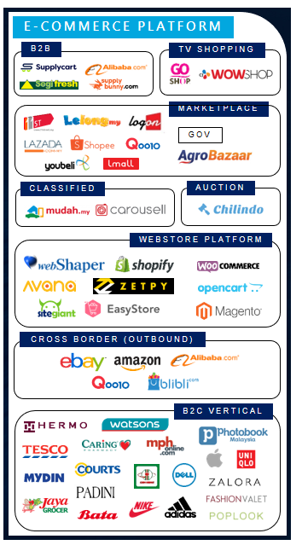
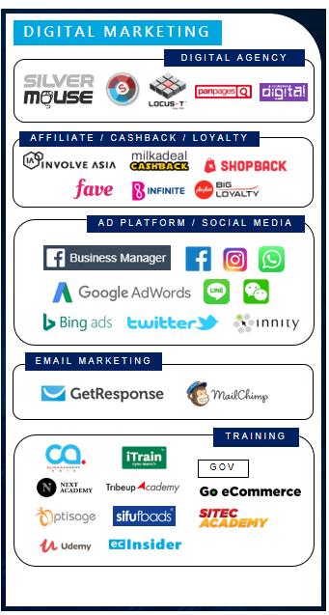
Malaysia eCommerce Landscape 2018

Slide 36
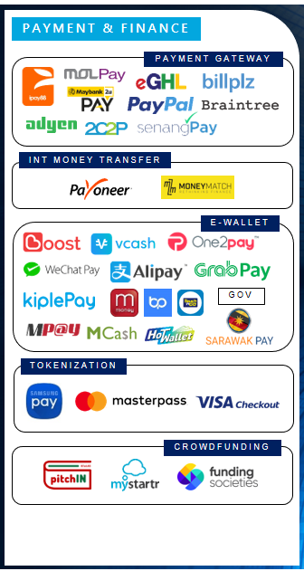
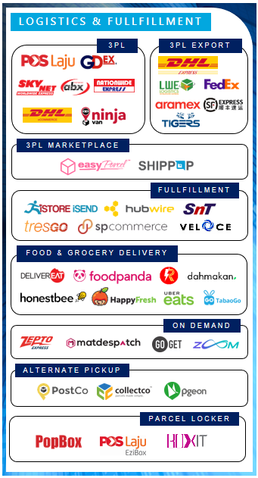
Malaysia eCommerce Landscape 2018
Source: https://www.ecinsider.my/2018/03/malaysia-ecommerce-landscape-2018.html

Slide 37
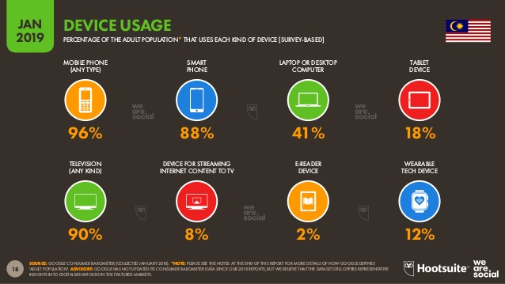

Slide 38
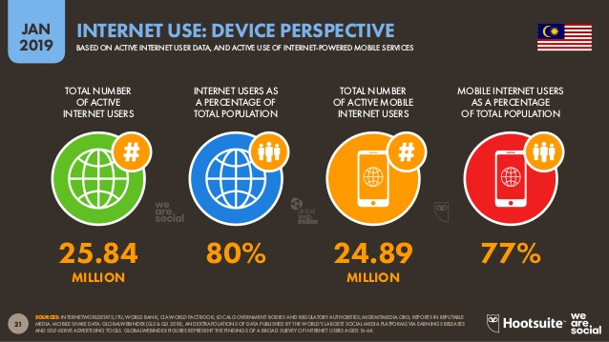

Slide 39
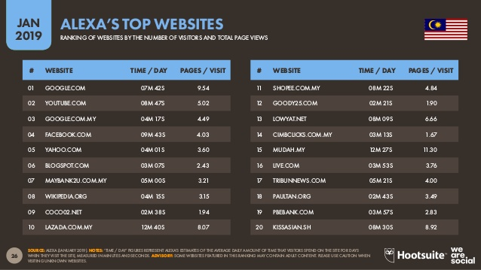

Slide 40
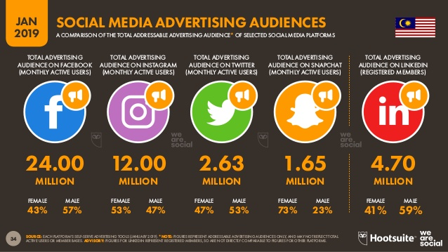

Slide 41
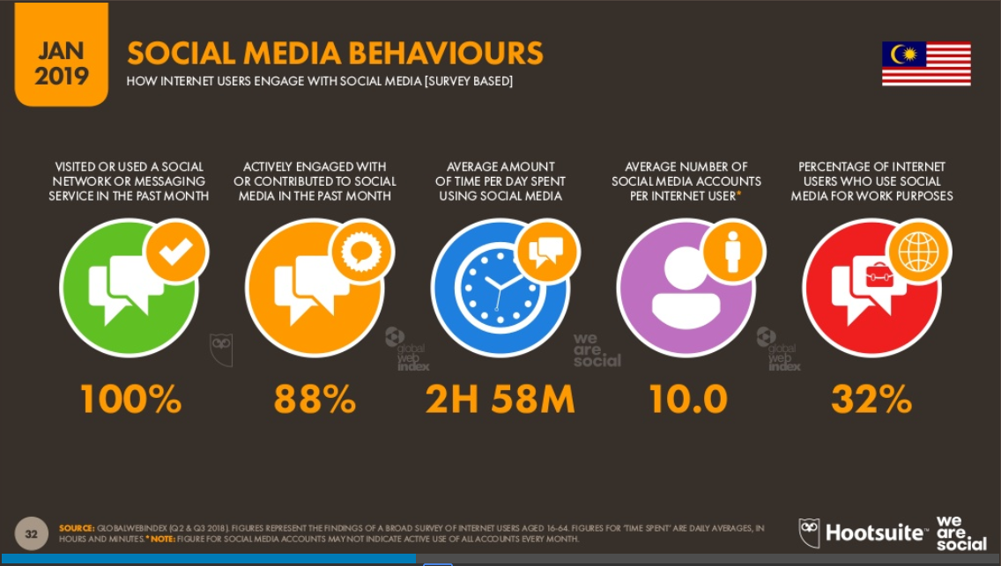
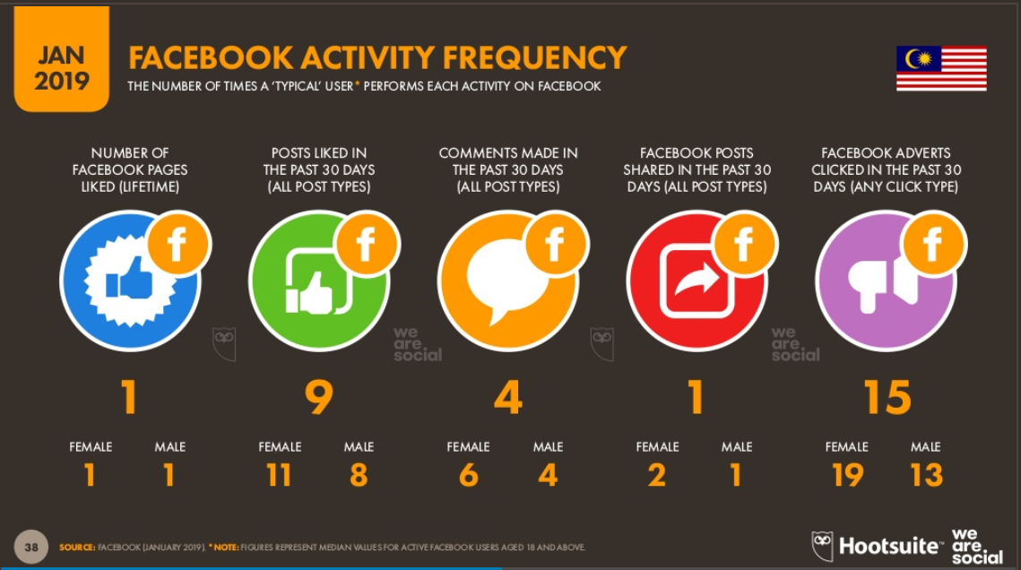

Slide 42
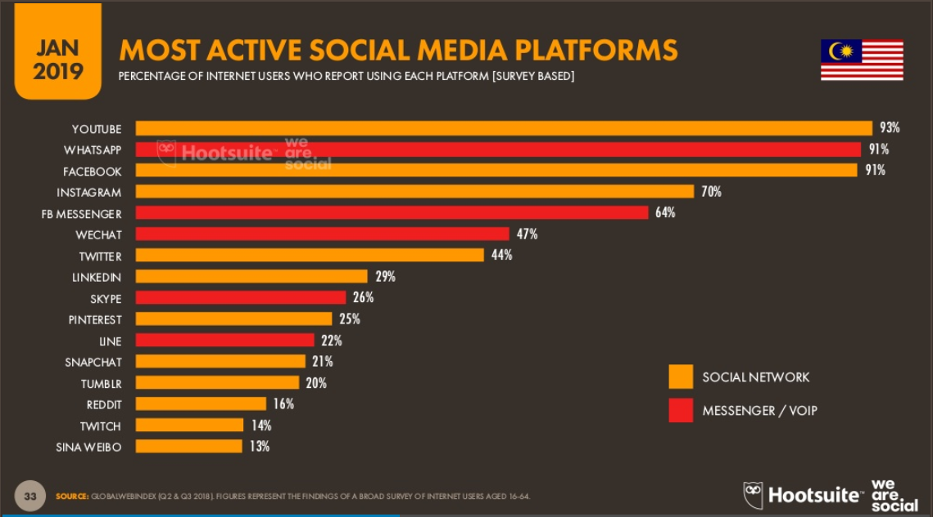

Slide 43
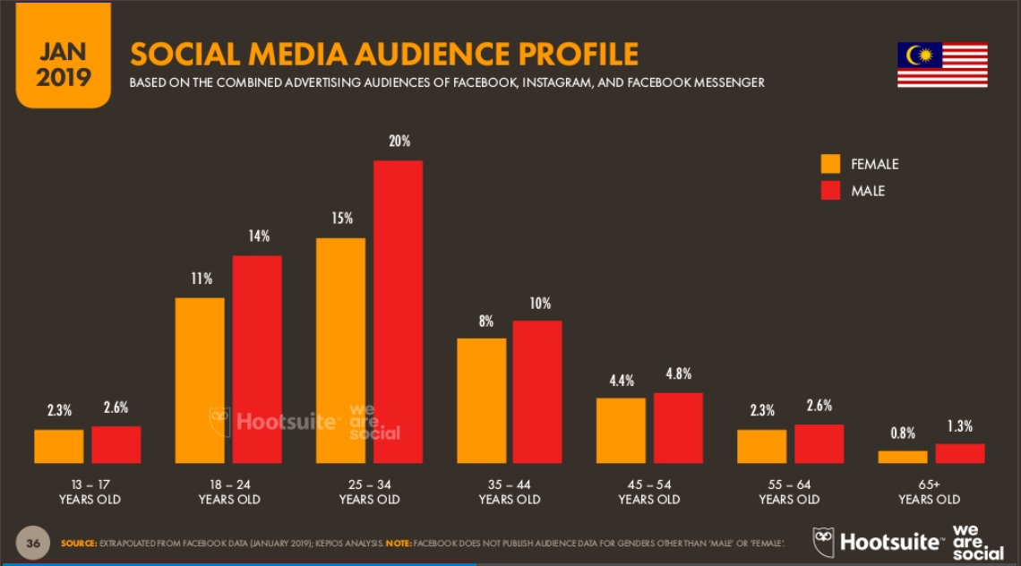

Slide 44


